Slide 1
Guide to repack & use Abbott Panbio ART test kits

Slide 2
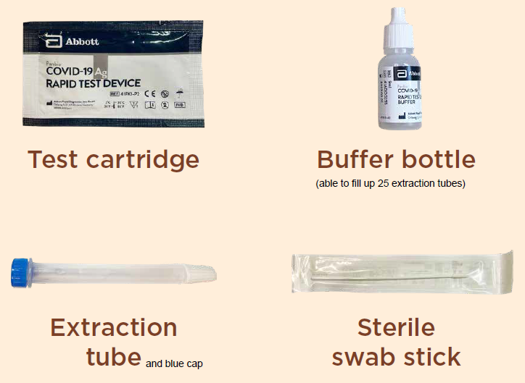
Box Contents
Each box contains 25 test cartridges, 25 extraction tubes, 25 Sterile swab sticks and 1 Buffer Bottle
Extraction Tube must be filled with the solution from Buffer bottle

Slide 3
Steps for repacking art kits (IF REQUIRED)
Preparation
Clean packing surface with alcohol wipe.
Put new box of kits on table surface.
Disinfect hands.
Wear face shield, face mask, and gloves. Minimise talking from this point onwards.
Maintain safe distance of 2m between packers.
Packing
Ensure each individual kit has 1x Test Cartridge, 1x Sterile Swab Stick and 1x Extraction tube (pre-filled).
When done with 1 box, disinfect hands with gloves on, using 70% alcohol hand rub.
Important to note before repacking:
Care must be taken to prevent contamination of the extraction tube when filling the buffer fluid.
Always ensure all the kits are within the expiry periods
Ensure the amount of Buffer fluid in all the Extraction Tubes are exactly at the “Fill-Line”
The Buffer fluid once dispensed in the Extraction Tube must be used within 48 hours
The unused Extraction Tube with the Buffer fluid is recommended to be stored upright to avoid leakage, and between the temperature of 2 to 30 deg Celsius
The Extraction Tubes stored under refrigeration must be allowed to stabilise at normal room temperature before use. Abbott recommends to use the Extraction Tubes 30 minutes after it has been taken out from the refrigerator.
Do not mixed Buffer fluid from different batches into the same Extraction Tube

Slide 4
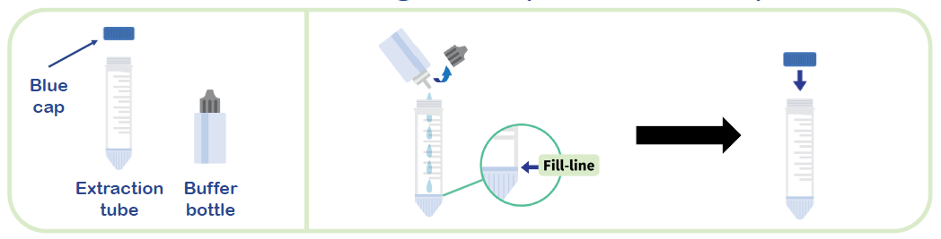
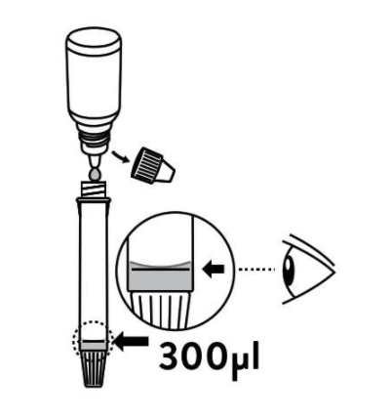
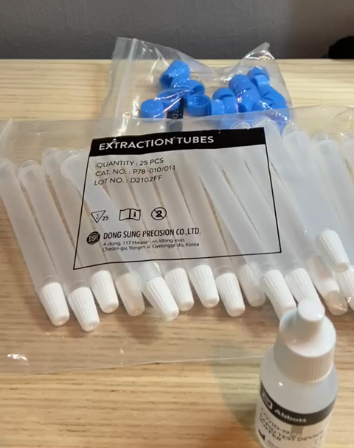
Preparation Stage: How to Fill the Extraction Tube with Buffer Solution
Fill Line
Tilt the buffer bottle
Fill the extraction tube with buffer fluid until it reaches the fill-line of the extraction tube
Close the nozzle (blue cap)
Click the play button to watch video instructions
The buffer bottle may be opened and resealed after each buffer preparation. The buffer is stable until expiration date if kept at 2-30 °C

Slide 5
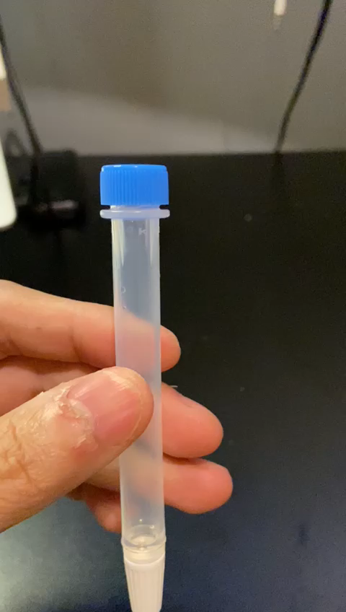
Employee needs to break swab stick at the break point
after swabbing
After swirling the swab stick 5x, employee conducting the self-swab should squeeze the extraction tube to extract swab specimen.
Next, look for the line around the middle of the swab stick and then break the stick at that point.
Tighten the blue cap after breaking the stick.

Slide 6
Instructions on how to use Abbott Panbio ART test kits
Self-Swab Instructions | PDF File for Printing
English

